Slide 1
Active mobility in Lagos, Nigeria: Commuters’ attitude, inherent challenges, and funding prospect
Presented at the 2022 ITF Summit Pre-Summit Research Day in Leipzig, Germany, on Tuesday 17 May 2022
Dr Emmanuel Mogaji
University of Greenwich, London, UK
Centre for Multidisciplinary Research and Innovation (CEMRI), Abuja, Nigeria
e.o.mogaji@greenwich.ac.uk

Slide 2
Active Transportation
By choice or by condition?

Slide 3
Objectives
1. Commuters' attitudes towards active mobility
2. Challenges with active mobility 3. Funding prospect for active mobility in developing countries

Slide 4
Lagos, Nigeria
Commercial hub of Nigeria
With an estimated 20 million people across 3577 km2, Lagos is Africa's most populous city with the highest population density in Nigeria.
An emerging economy, which is facing institutional adversity and underlying and persistent economic challenges.

Slide 5
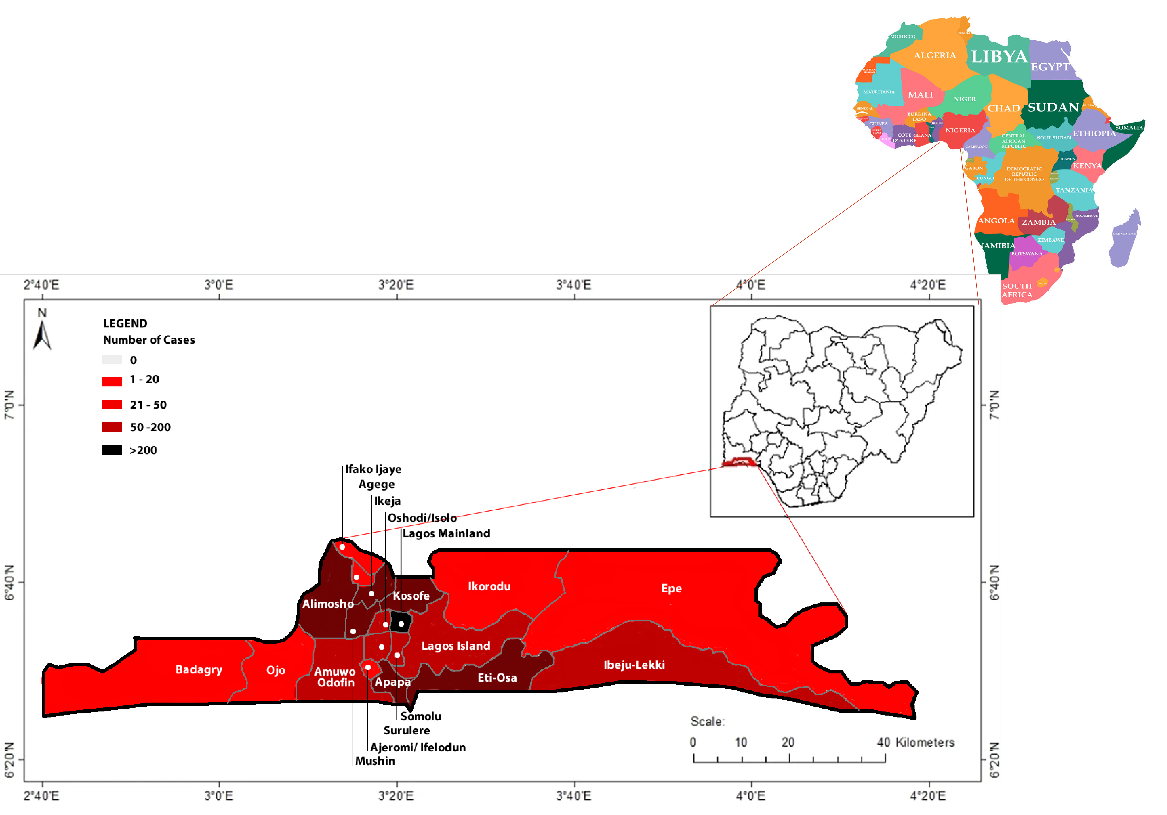

Slide 7
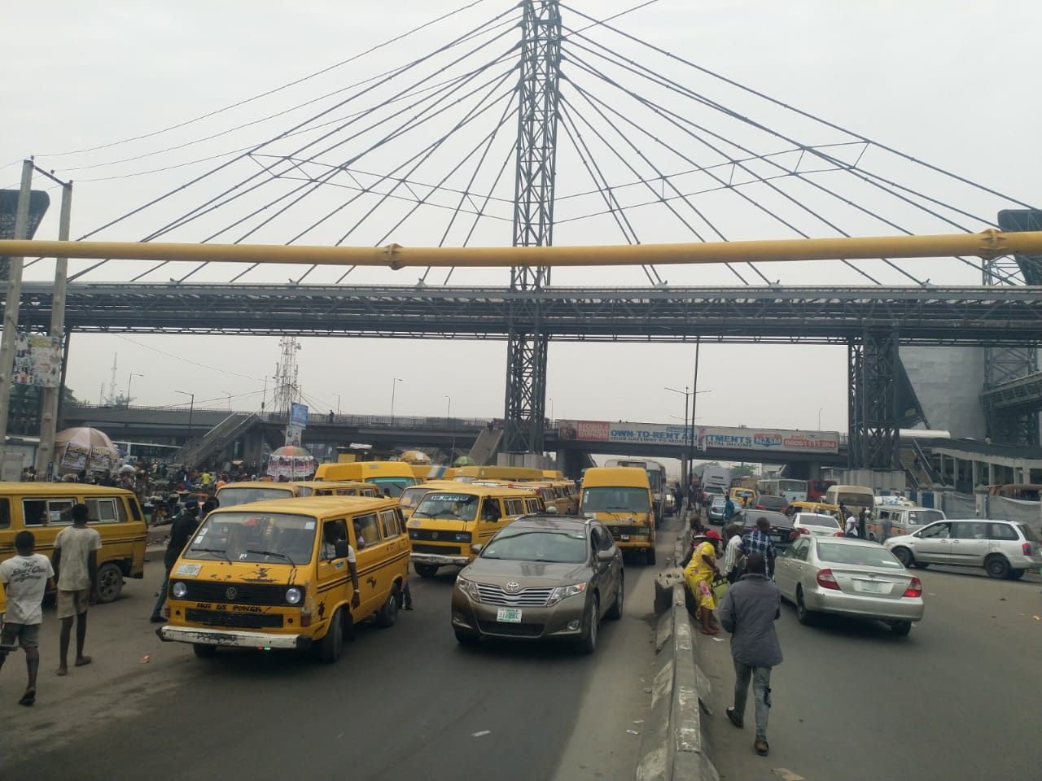
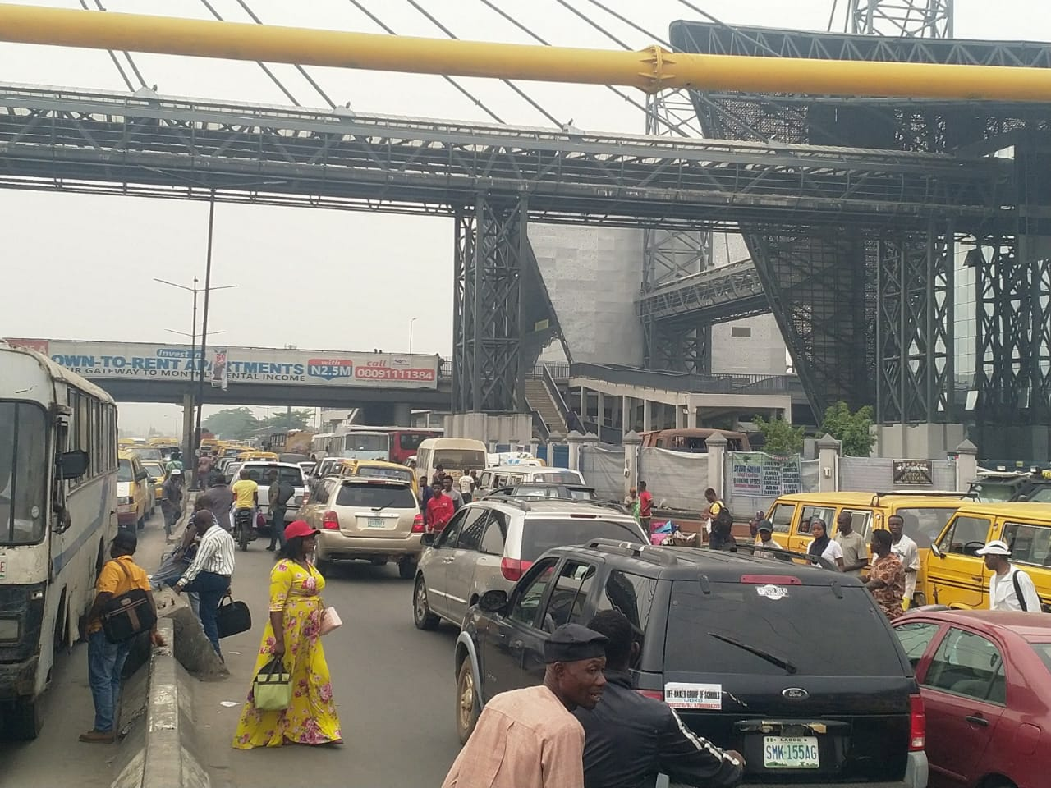

Slide 8
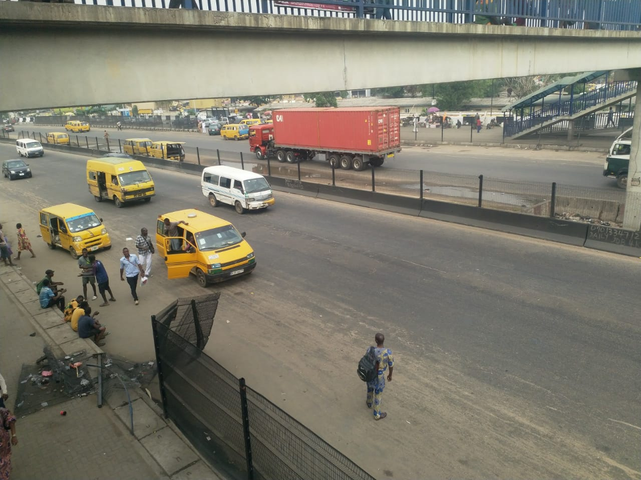

Slide 9
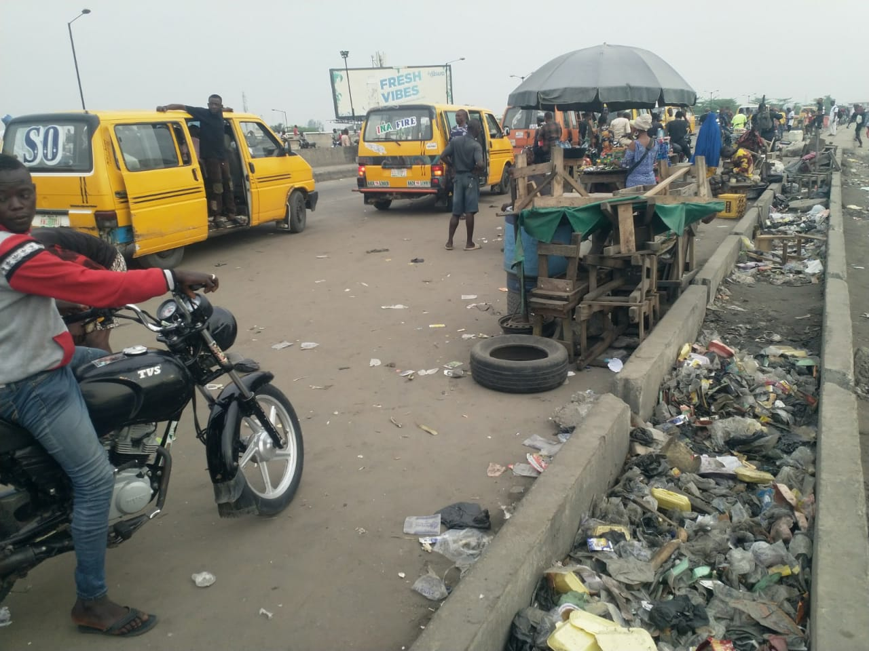

Slide 10
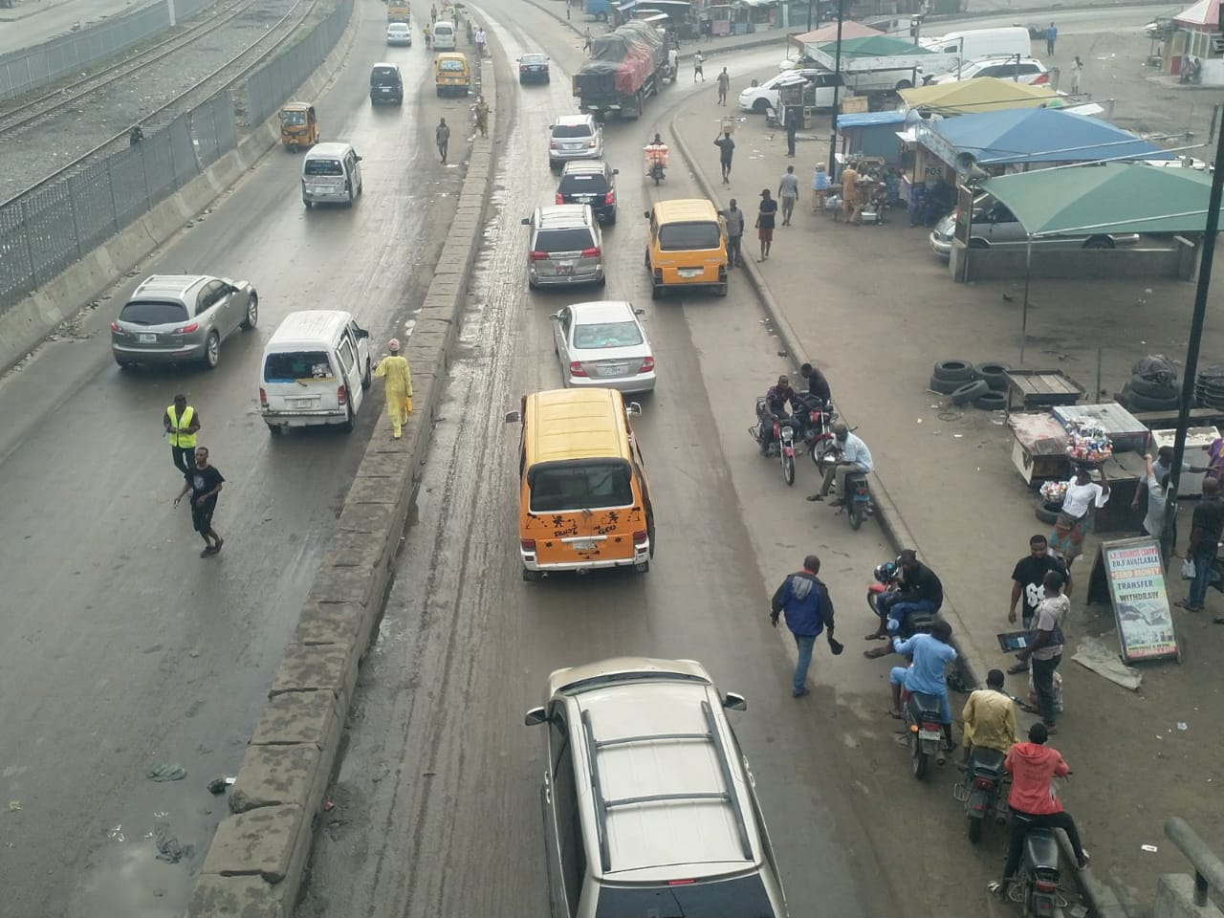

Slide 11
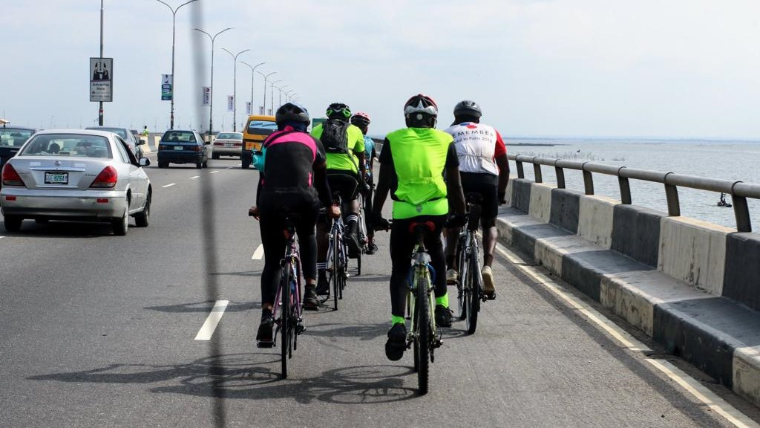

Slide 12
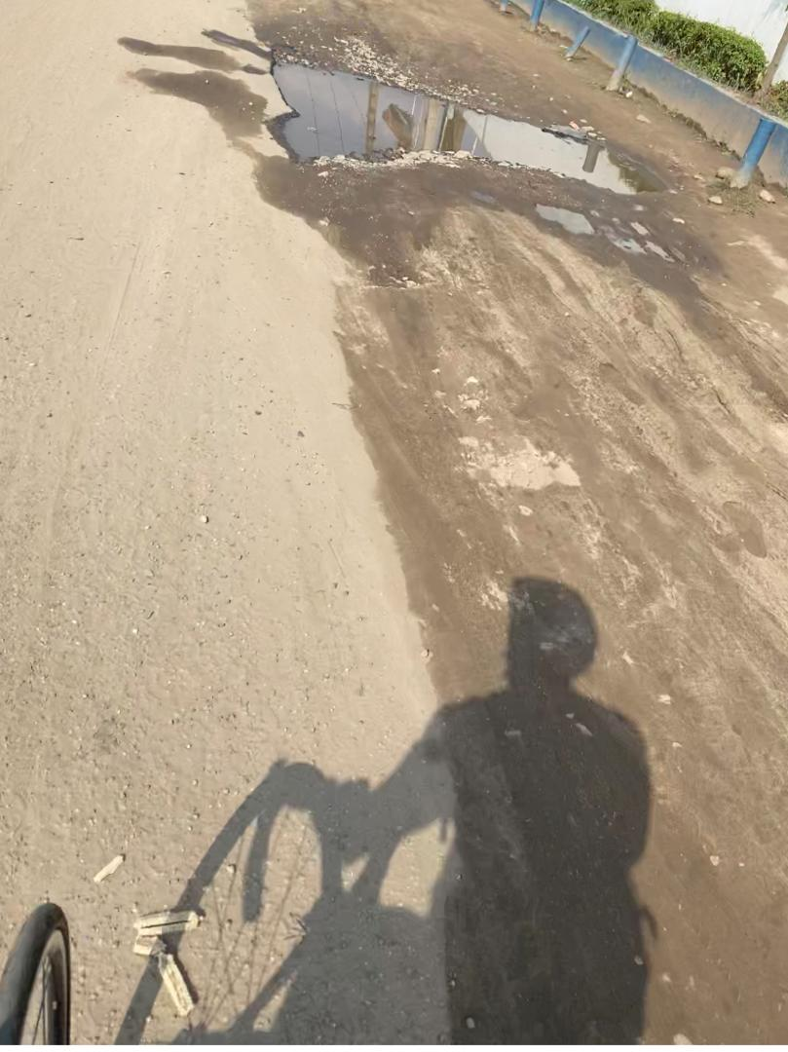
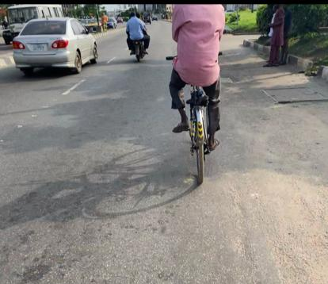

Slide 13
Qualitative Study
Semi-structured interview with participants in Lagos
Ethnographic study and observation of infrastructures
Semi structure interview with subject matter experts

Slide 14
Key findings
Active transportation is often by condition and not a choice
People don’t consider walking as a mode of transportation
Not safe cycling and not conversant with scoters.

Slide 15
Key findings
Built environment not conducive
Attitude of other road users not appealing
Huge investment on motorised transportation

Slide 16
Key findings
Growing exchange rate will discourage investment
Global clamor for sustainability presents opportunities
Going away from norms - corruption and political affiliations

Slide 18
Policy implication
The political will to make a change
Awareness for stakeholders
Place-centred approach
Improving the built environment – location of activities and transport mode
Private and public organization’s involvement?
Small changes at a time
Investment in equitable active transportation
Accountability

Slide 19
Conclusion
Active transportation is important, irrespective of the country
Though there are inherent challenges, it is possible.
Awareness, availability and accountability are key.

Slide 20
Active Transportation
By choice or by condition?

Slide 21
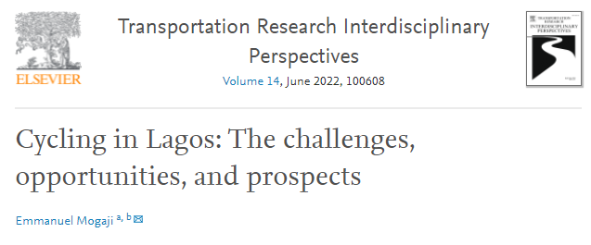
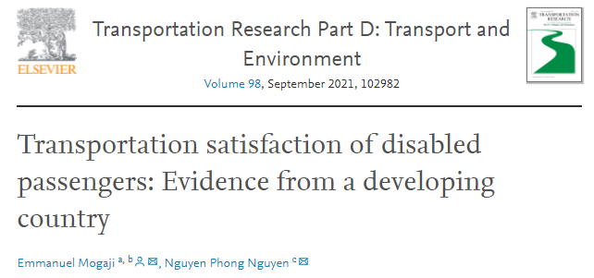
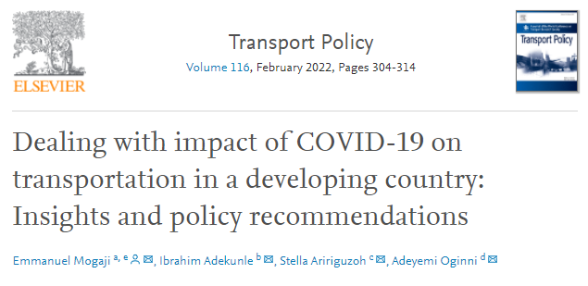
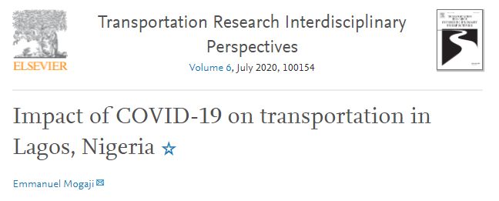
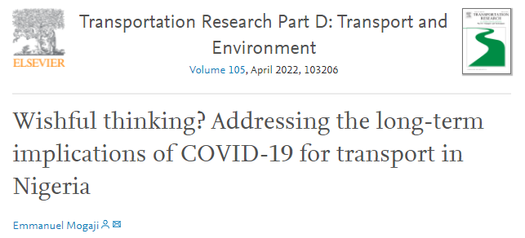

Slide 22
Thank you.
Dr Emmanuel Mogaji
e.o.mogaji@greenwich.ac.uk

