Slide 1
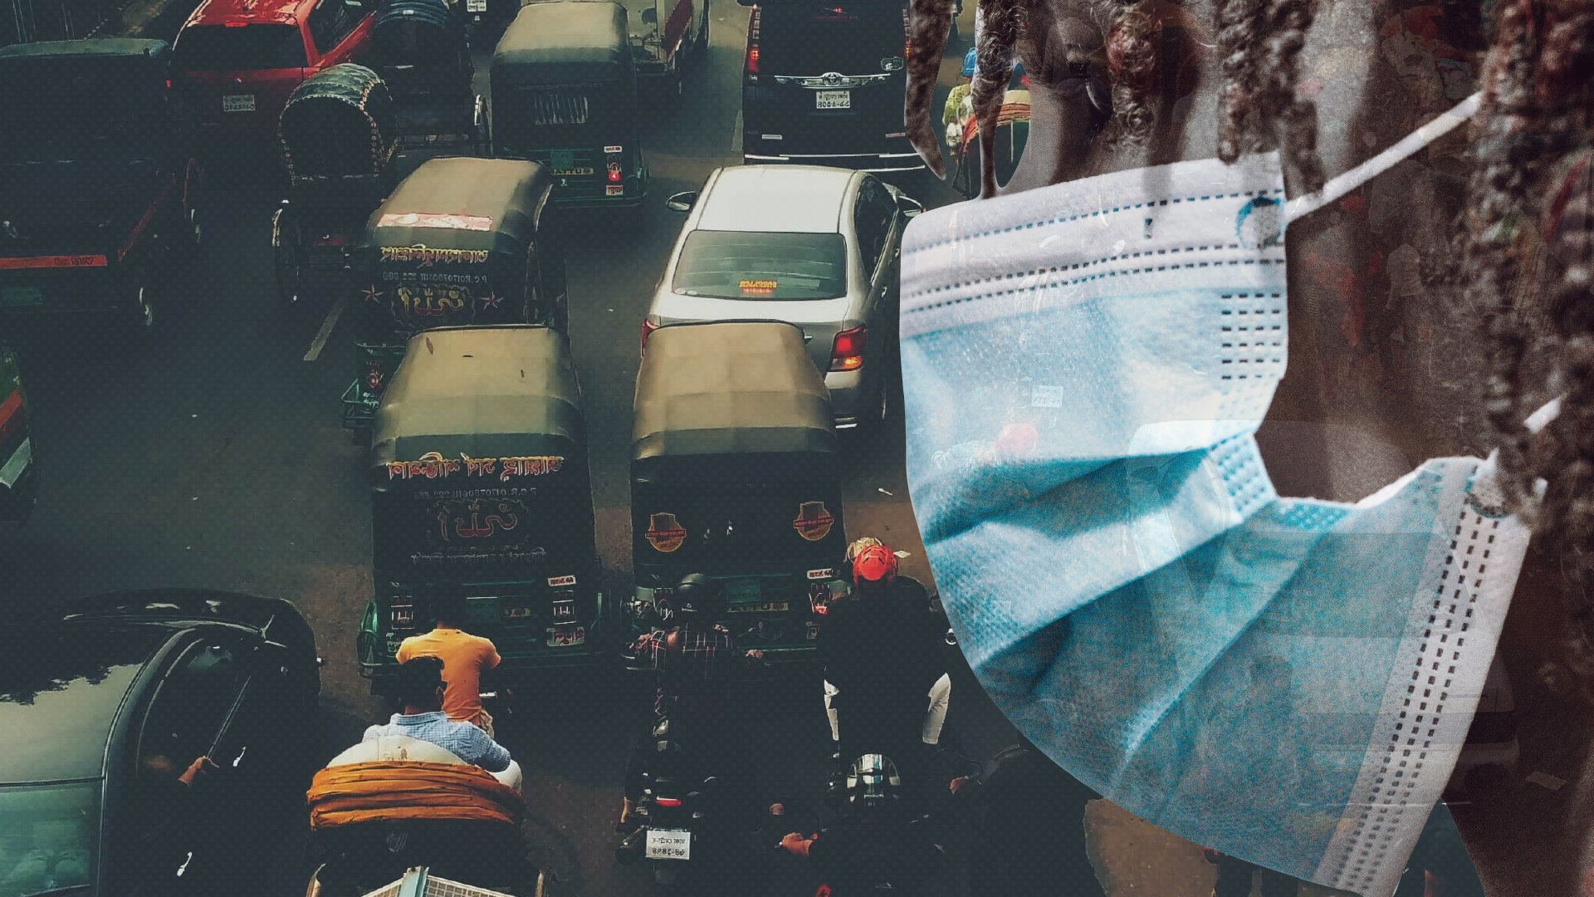


Transitioning informal public transport services for a low carbon future in Sub-Saharan Africa
17 May 2022
Simon Saddier, Transitec
Tim Durant, Vectos | part of SLR

Slide 2
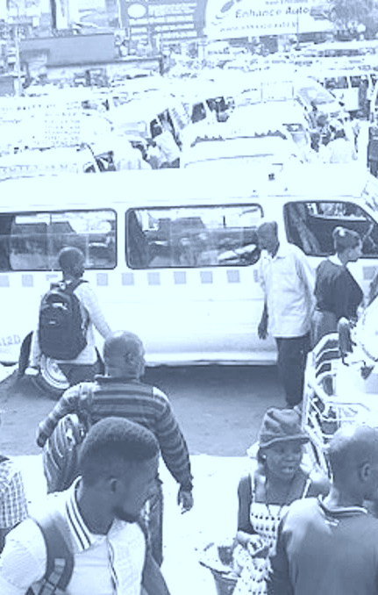
Transitioning the policy debate, stakeholder relations and informal transport services…
…for the achievement of climate mitigation, affordable mobility, employment and safety
Motivation and Ambition
Photo courtesy of Wikimedia Commons
Creative Commons: author Ratchit.14
Notes:
Introduce - Welcome the opportunity to provide an introduction to the TRANSITIONS project, which focuses on the role and future possibilities of ‘informal public transport’
Nairobi Experience - Experience of using the types of minibus shown, which provide the main form of mobility in the majority of cities in Sub-Saharan Africa.
Situations where at least partial replacement of informal transport with BRT schemes have been delayed or implemented but failed, in part due to resistance or potentially a lack of involvement of the informal public transport sector.
Acknowledge problems – but are there ways in which the ‘informal public sector’ can be better supported?

Slide 3
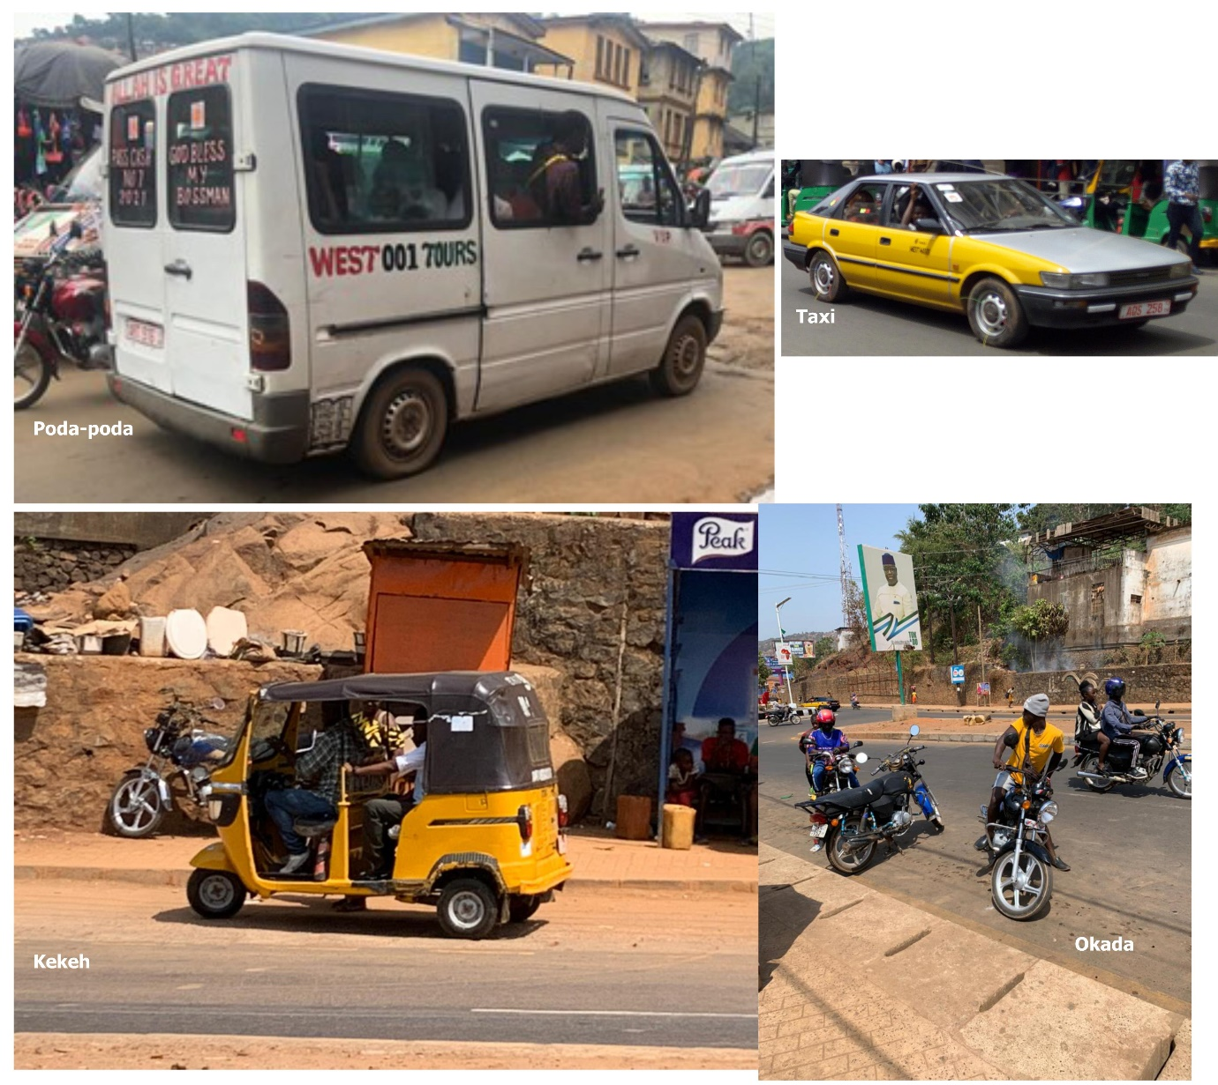
Informal ‘public’ transport
City | Informal (Public) Transport modal share
Accra | 62.2% incl. Trotro
Kumasi | 65% Trotro
Freetown | 28% Minibuses / 27% shared taxis
Cape Town | 54% Minibus taxis
Harare | 90% (Minibuses & Mushikashika)
Maputo | 32.9% Chapa, MyLoves additionally

Slide 4
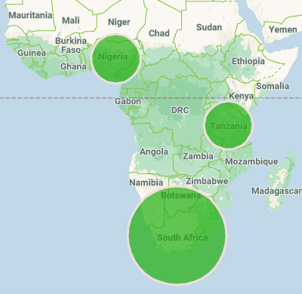
Time to revisit policy agendas and funding priorities
Formalisation
Decline in viability
Informalisation
Decline in service quality
Problems for BRT
implementation:
Lack of technical capacity
Opposition from existing bus operators
Underestimate effort (optimism bias)
Insufficient funding for operation
Rushed inauguration
Lindau et al. 2014
Gwilliam 2008
BRTdata.org

Slide 5
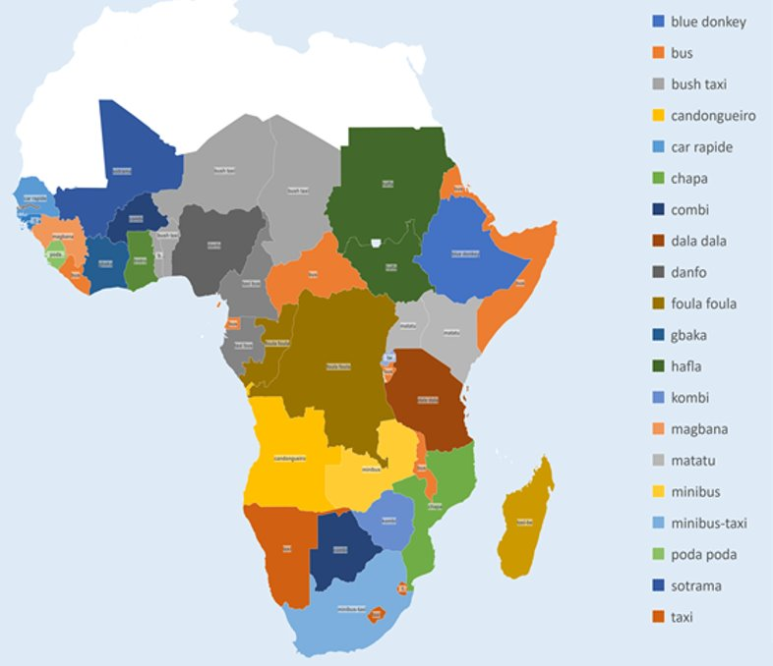






Research cities & partners

Slide 6
Phase 1: Literature review on ‘informal public transport’
Nine thematic literature searches yielded 322 publications
Six case city searches yielded 128 publications
Number of publications per year

Slide 7
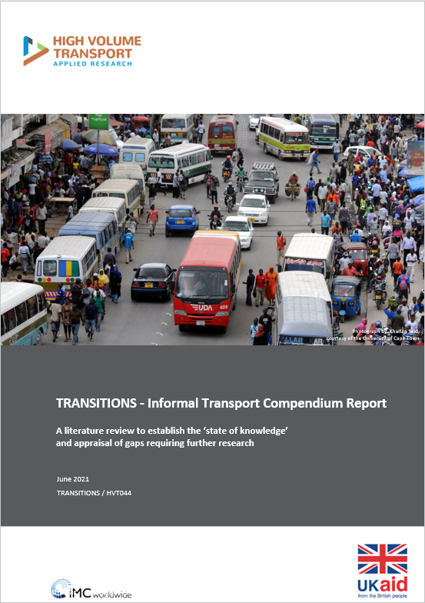
Phase 1: Literature review on ‘informal public transport’
Beneficial practices
digitalmatutus.com
Savings and Credit Cooperatives (SACCOs)
Recapitalisation and renewal programmes
City centre vehicle size restrictions
And problematic practices: Cashless Fare Collection
https://transport-links.com/download/
transitions-informal-transport-compendium-report/

Slide 8
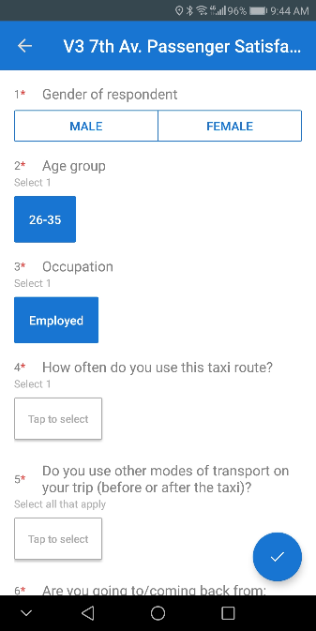
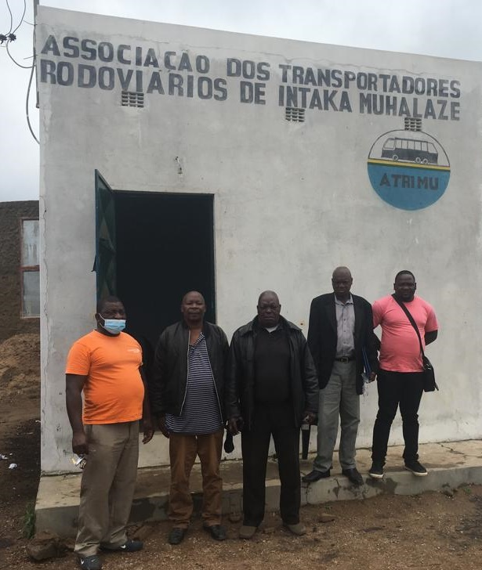

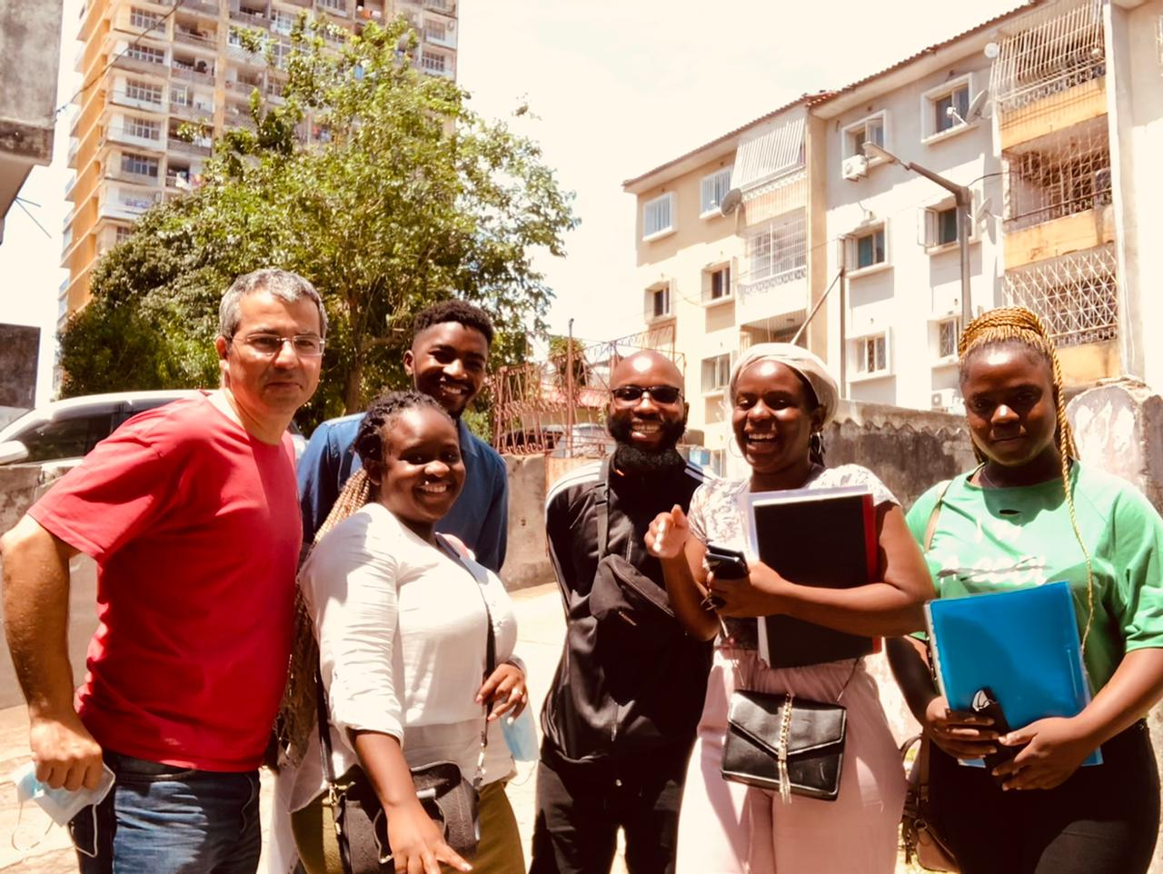
Phase 2: Research activities across five cities
Stakeholder interviews
GPS tracking & fuel consumption
EFFICIENT
CLEAN
Passenger
Opinion
Survey
AFFORDABLE

Slide 9
Phase 3: Towards a routemap for clean, affordable and safe mobility
CONTEXT, ATTITUDES, BENEFITS & PROBLEMS
What is the attitude and policy position towards informal public transport and is this informed by good evidence?
IPT ORGANISATION & ENGAGEMENT
What is the organisational make-up of the sector/s and with which actors can we best engage?
CITY CAPACITY & CAPABILITIES
What is the status of PT services, IPT regulation and capacity of public authorities to support improvements?
ACTIONS for clean, affordable & safe IPT
What are the most promising strategic ‘routes’ and actions to support service improvements and reduce problems?
Infrastructure (e.g. lanes, terminals)
Attitudes and policy
Organisational & financial models
PT status & integration
UAR and service integration (e.g. vehicle size restrictions)
IPT Network characteristics
Labour conditions & remuneration
IPT regulation & enforcement
Fleet & fuel (e.g. Finance, maintenance support)
Business development and training
Benefits & externalities
Engagement context
Current extent of IPT support
Passenger services (e.g. network mapping and info)

Slide 10
Accra - Travel behaviour
Notes:
Overwhelmingly regular users
Some infrequent
Work is the main trip purpose, but very gendered

Slide 11
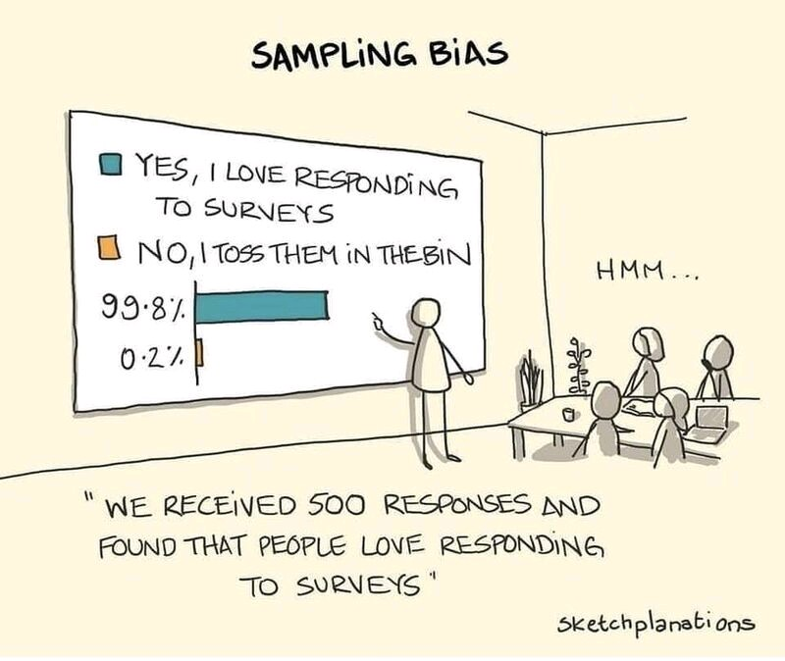

Slide 12
Accra - Passenger satisfaction and needs
“The operators should talk to the drivers to reduce their speed.”
“Some of the young drivers overspeed and makes it unsafe in trotro.”
“Refresher training must be organized for drivers on the effects of speeding”
“The terminal is always messy whenever it rains.”
“Fill the terminal with chippings so that the terminals look a little better.”
“The sanitation of the terminal needs to be improved.”
“They should stop increasing the fare regularly”
“Transport fare is too much”
“The charge a lot on the goods we carry. They should be a bit considerate.”

Slide 13

Finding no. 2: movement pattern
Notes:
Results for 12 vehicles in the sample:
Total km driven = ~13,000 veh-km
Daily average per vehicle = 168 km
Median = 186 km/veh/day
Approximately 3 round trips/day on weekdays
33% more km/veh on Saturday (4 round trips)
Sunday = half of Saturday

Slide 14
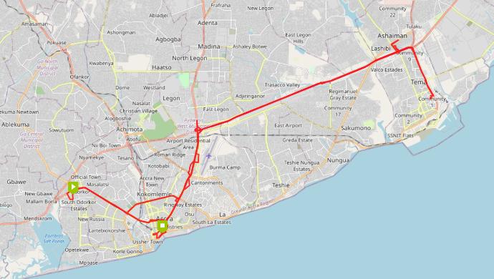

Slide 15
Accra - Vehicle use and productivity
Daily active hours by vehicle
Productivity by day of the week

Slide 16
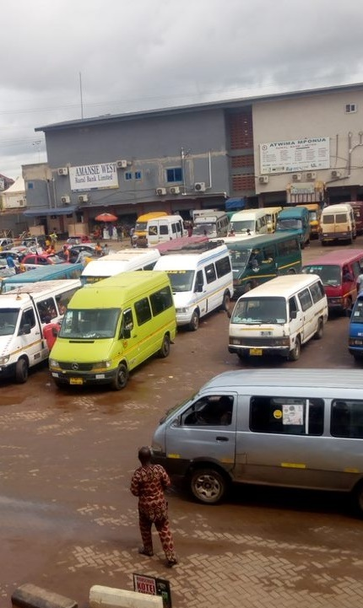
Accra - Fuel consumption over a week
Car models used for “trotros” in Ghana include Toyota, Nissan and Mercedes Benz Sprinter

Slide 17
Relations between actors
Estimated 300 trotro terminals in GAMA
Research undertaken with Ghana Private Road Transport Union (GPRTU) and Ghana Cooperative Transport Association (GCTA)
Licensing: Legal requirement to register with a union or association:
        Greater assurance of full capacity
        Financial and welfare support
        Training and investment
BUT growing presence of ‘floaters’
Municipal fragmentation: resulting regulatory void / lack of coordination

Slide 18
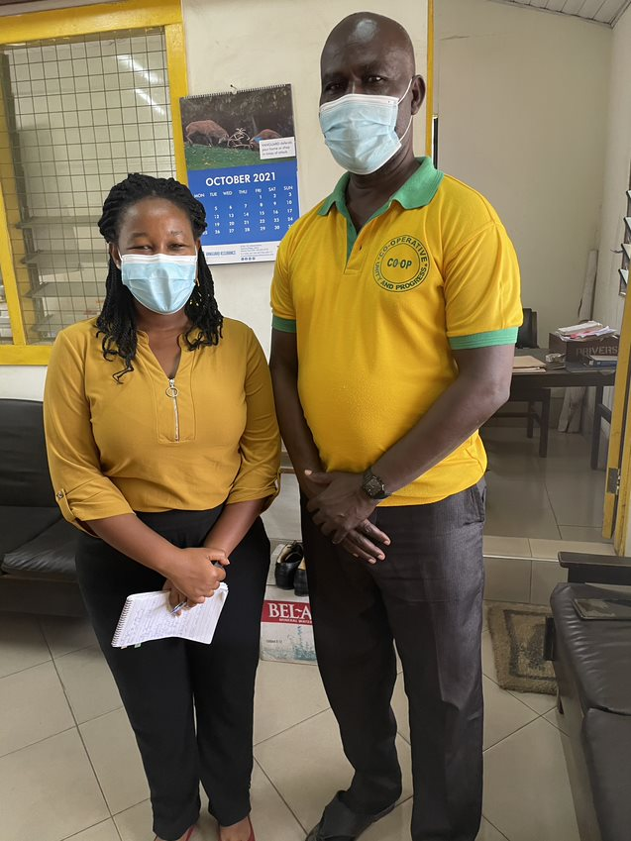
Concerns from the industry
BRT scheme: perceived failure to integrate trotro operators
Infrastructure: suggested that improving state of stations and terminals could significantly improve quality of service.
Fare setting and financing
drivers currently have to work longer hours to match the same revenues they made 10 years ago
Acknowledgement of Ministry of Transport support relating to concessional loans for minibus purchase (MASLOC)
Interview with Mr. Hoffmann,
President of Co-Op Union in Accra

Slide 19
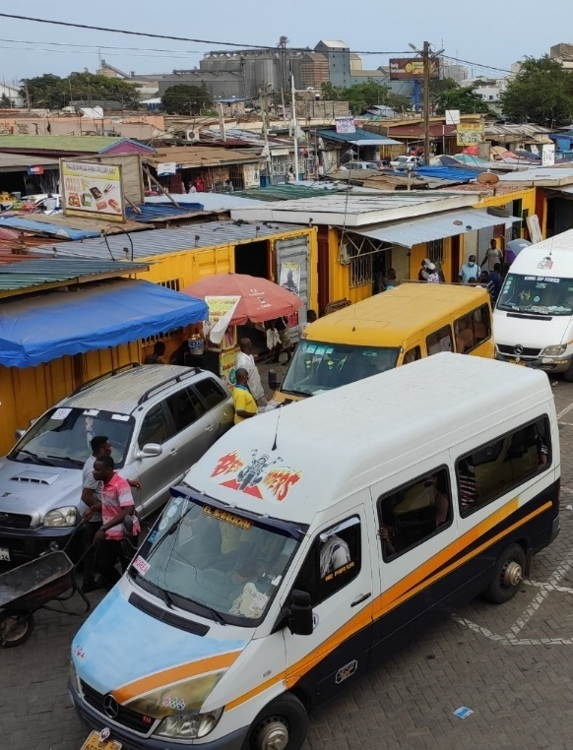
Closing remarks
A self-organized transport system born out of a lack of public alternatives
Weak regulation -> oversupply -> low productivity
Ambiguous attitude of authorities: patronage and modernization plans
Public transport perceived as a source of revenue (instead of potential recipient of subsidies)
“Remove and replace” cannot be the way forward, need to professionalize and integrate

Slide 20
Thanks for your attention
Tim Durant Simon Saddier
Vectos | part of SLR Transitec
timothy.durant@vectos.eu simon.saddier@transitec.net

