Slide 1

Recommendations based on case studies in Japan for sustainable mobility using digital data
～Response to aging of society～
Wataru KOBAYASHI
Research Fellow, Japan Transport & Tourism Research Institute (JTTRI)

Slide 2
Introduction
The population growth period ended in 2010.
The share of the elderly population in Japan (29.1%) is the highest in the world.
（Statistics Bureau of the Ministry of Internal Affairs and Communications）
Status of Japan
Required Changes in Mobility Services
What is currently required for Japan's public transportation includes;
  ensuring fine-tuned mobility services in daily living areas and sightseeing areas
  ensuring mobility services for the elderly, people with disabilities, and people with limited access to transportation
  ensuring mobility services in regional areas
  maintaining services in the face of declining user numbers and labor shortages

Slide 3
Study Overview
Purpose
Regarding new mobility services,
  Collect practical examples to accelerate implementation;
  Examine measures to establish a sustainable form of the business model and make problem-solving recommendations.
(from the viewpoint of utilizing digital technology in line with solutions to each local problem)
Method
Investigate the cases by four area types (large urban areas, regional urban areas, rural areas, and tourist areas) of Japan.
Conduct interview surveys with related parties for each case and experts in mobility services.
Summarize the results based on opinions from experts.
Study Period
July 2020 – March 2022

Slide 4
Initiatives Related to Smart Mobility
Considerations are underway in many regions of Japan
In Japan, the Ministry of Land, Infrastructure, Transport and Tourism (MLIT) and the Ministry of Economy, Trade and Industry (METI) implemented support projects to promote MaaS.
Table 1: Numbers of support projects adopted in the past three years
 | MLIT | METI | MLIT and METI
2019 | 15 | 9 | 4
2020 | 33 | 14 | 3
2021 | 12 | 14 | ０
The number of support projects reached 116 in 2021 (related projects such as Smart Cities included).

Slide 5
Features of Public Transportation in Japan
Most public transport in Japan is operated by private operators
Public, 16
Public-Private Joint Entities, 46
Public, 11
Private, 111
Bus Operators (Holding 30 or More Vehicles: Charter Bus Operators excluded )
Railway Vendors

Slide 6
Issues Related to Digital Data
Issue 1:
Issue 2:
Sharing information on assistance needed
Issue 3:
Remedies for digitally- disadvantaged people
Setting-up of data platform
Explained in Case 1 and 2
Explained in Case 3
Explained in Case 4 and 5

Slide 7
Issue 1: Setting-up of Data Platform
Present Status
Private operators and others have begun to build platforms tailored to the MaaS project
Issues
・ The construction of the MaaS platform is costly for new operators, and is an obstacle for new entrants
・ Various MaaS platforms have been built, but data linkage between them may not progress well.
Create an environment related to data platform that enables new businesses to enter easily
Recommendations
Develop criteria for administrations to promote data linkage

Slide 8
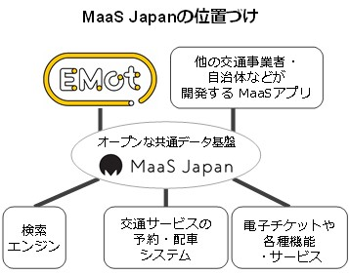

Case 1: Private transport operators develop MaaS data infrastructure
Issue 1: Setting up infrastructure data
Goal
Develop an environment in which diverse entities can enter
Status of “Maas Japan”
Other Maas application
EMot：MaaS application developed by transport operators.
Other Maas application
MaaS Japan：An open platform with search, reservation, and payment capabilities.
Open Shared Data Infrastructure
Booking, Dispatch System for Transportation Service
Electronic Tickets and Various Functions and Services
Search Engine
Notes:
こちらは取組概要を示した図です。
・先ず、バイタルリードというコンサルタントが配車システム、大田市が補助、タクシー会社が運航、と役割分担をして、定額タクシーを提供しています。
・住民は定額の月額利用料を支払い、タクシーが乗り放題になります。
・年金から月額利用料を支払うことも負担になるということから、地域で小さなビジネスを立ち上げ、利用者の収入を少しでも増やすことで、月額利用料の支払いに充てられるよう、取り組みが行われています。
・また、家の電球を取り換えるなどの仕事も行うことで、収入を増やそうとしています。
・住民の外出機会を増やすなどの健康活動を増やすことで、介護予防効果も期待されています。
このように、過疎地における移動手段の確保にとどまらない、地域の暮らし方にまで踏み込んだビジネスモデルを志向されています。

Slide 9
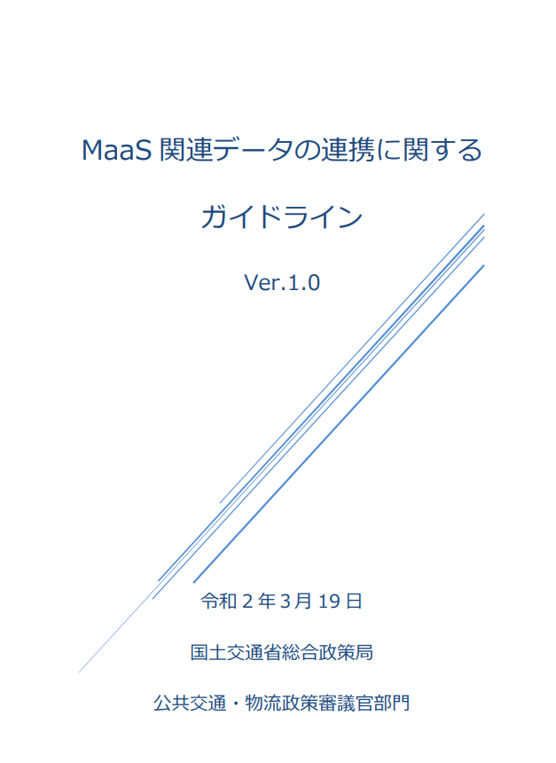
Case 2: Government Develops Guidelines on Data Linkages
Issue 1: Setting up infrastructure data
Goal
Develop an environment in which diverse entities can enter
In 2020, MLIT formulated guidelines on MaaS data linkages.
The purpose of the guidelines is to
organize data link rules, rules required for MaaS, and data link method.
promote the provision of MaaS.
promote the cooperation between MaaS.
Figure3: Guidelines for Maas-related Data Linkage
Notes:
こちらは取組概要を示した図です。
・先ず、バイタルリードというコンサルタントが配車システム、大田市が補助、タクシー会社が運航、と役割分担をして、定額タクシーを提供しています。
・住民は定額の月額利用料を支払い、タクシーが乗り放題になります。
・年金から月額利用料を支払うことも負担になるということから、地域で小さなビジネスを立ち上げ、利用者の収入を少しでも増やすことで、月額利用料の支払いに充てられるよう、取り組みが行われています。
・また、家の電球を取り換えるなどの仕事も行うことで、収入を増やそうとしています。
・住民の外出機会を増やすなどの健康活動を増やすことで、介護予防効果も期待されています。
このように、過疎地における移動手段の確保にとどまらない、地域の暮らし方にまで踏み込んだビジネスモデルを志向されています。

Slide 10
Issues Related to Digital Data
Issue 1:
Setting-up of data platform
Issue 2:
Sharing information on assistance needed
Issue 3:
Remedies for digitally- disadvantaged people
Explained in Case 1 and 2
Explained in Case 3
Explained in Case 4 and 5

Slide 11
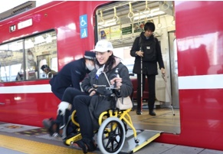
Issue 2: Sharing Information on Assistance Needed
If assistance is required while being transported, the user themselves will request service assistance from the respective transportation operator.
Present Status
Issues
There are troublesome obstacles for connecting public transports.
Assistance available is different among transportation operators and tourist facilities.
Recommendations
Sharing information among transportation operators and tourist facilities regarding assistance needed for a particular traveler

Slide 12
Case 3: Experimental Demonstration of MaaS Advocated by Airline
Issue 2: Sharing Information on Assistance Needed
Promote the acquisition and organization of data taking account of the public value of data utilization
Goal
• Users can decide on a route that allows them to move in comfort and without stress.
• Share the user's own characteristic information and desired assistance between business operators
[Share both static and dynamic data]
Static data: Existence of home door installation, stair position.
Dynamic: Users’ location, traffic congestion such as the platform, construction works, occupancy of facilities such as toilets and nursing rooms, and others.
[Problem]
Cost for maintenance and update of data mentioned above.
  Information required varies by users and facilities
  Much cost and work needed to maintain and update related data.
Assignment of the administrator of the information?
  Management of personal information and the confidential information of business operators needed
Notes:
こちらは取組概要を示した図です。
・先ず、バイタルリードというコンサルタントが配車システム、大田市が補助、タクシー会社が運航、と役割分担をして、定額タクシーを提供しています。
・住民は定額の月額利用料を支払い、タクシーが乗り放題になります。
・年金から月額利用料を支払うことも負担になるということから、地域で小さなビジネスを立ち上げ、利用者の収入を少しでも増やすことで、月額利用料の支払いに充てられるよう、取り組みが行われています。
・また、家の電球を取り換えるなどの仕事も行うことで、収入を増やそうとしています。
・住民の外出機会を増やすなどの健康活動を増やすことで、介護予防効果も期待されています。
このように、過疎地における移動手段の確保にとどまらない、地域の暮らし方にまで踏み込んだビジネスモデルを志向されています。

Slide 13
Case 3: Experimental Demonstration of MaaS Advocated by Airline
Issue 2: Sharing Information on Assistance Needed
Notes:
こちらは取組概要を示した図です。
・先ず、バイタルリードというコンサルタントが配車システム、大田市が補助、タクシー会社が運航、と役割分担をして、定額タクシーを提供しています。
・住民は定額の月額利用料を支払い、タクシーが乗り放題になります。
・年金から月額利用料を支払うことも負担になるということから、地域で小さなビジネスを立ち上げ、利用者の収入を少しでも増やすことで、月額利用料の支払いに充てられるよう、取り組みが行われています。
・また、家の電球を取り換えるなどの仕事も行うことで、収入を増やそうとしています。
・住民の外出機会を増やすなどの健康活動を増やすことで、介護予防効果も期待されています。
このように、過疎地における移動手段の確保にとどまらない、地域の暮らし方にまで踏み込んだビジネスモデルを志向されています。

Slide 14
Issues Related to Digital Data
Issue 1:
Setting-up of data platform
Issue 2:
Sharing information on assistance needed
Issue 3:
Remedies for digitally- disadvantaged people
Explained in Case 1 and 2
Explained in Case 3
Explained in Case 4 and 5

Slide 15
Issue 3: Remedies for Digitally-Disadvantaged People
Present Status
Many MaaS require smartphone apps to provide search, reservation, and payment services.
Issues
People who are not familiar with handling smartphones, such as the elderly, cannot use the service.
Figure: Smartphone ownership by age group in Japan 2020
Set up a booking method that does not require a smartphone.
Recommendations
Help users increase their smartphone usage.

Slide 16
Case 4: Demand Service Systems Developed by Automobile Parts Manufacturers
Issue 3: Responding to digitally disadvantaged people
Goal
MaaS operators provide services that meet the needs of residents
The Toyota Group automobile parts manufacturer "Aisin" has developed a system infrastructure for AI demand services, which has been centrally deployed in 26 municipalities in Japan.
Operation is conducted by regional taxi operators. Common operators are responsible for dispatching vehicles to achieve efficiency.
All information regarding the order of vehicle dispatch and route of the trip is managed digitally, but the method of booking from the user is by phone, internet, email, and IVR.
There are many elderly users, and more than 95% of the bookings are made through telephone.
【愛知県豊明市】
*Note: Approximately 1,700 elderly people are registered members.
Consolidate operations from all over the country in one place.
Notes:
こちらは取組概要を示した図です。
・先ず、バイタルリードというコンサルタントが配車システム、大田市が補助、タクシー会社が運航、と役割分担をして、定額タクシーを提供しています。
・住民は定額の月額利用料を支払い、タクシーが乗り放題になります。
・年金から月額利用料を支払うことも負担になるということから、地域で小さなビジネスを立ち上げ、利用者の収入を少しでも増やすことで、月額利用料の支払いに充てられるよう、取り組みが行われています。
・また、家の電球を取り換えるなどの仕事も行うことで、収入を増やそうとしています。
・住民の外出機会を増やすなどの健康活動を増やすことで、介護予防効果も期待されています。
このように、過疎地における移動手段の確保にとどまらない、地域の暮らし方にまで踏み込んだビジネスモデルを志向されています。

Slide 17
Reference
Aishin
Toyota Group
Company Name: Aisin Corporation
Established: August 31, 1965; Merger on April 1, 2021 of Aishin Corporation and Aishin AW
Headquarters: 2-1 Asahi-Cho, Kariya City, Aichi Prefecture
Capital and Sales: Capital: JPY45 Billion;Sales: JPY3.526 trillion (March, 2021)
Consolidated Subsidiaries: 208 companies (Domestic: 75; International: 133)
No. of Employees: Consolidated: 119,535; Single: 37,644
Business Content: Automobile components; Energy and life-related product manufacturing and sales
Toyota Industries Corporation
Toyota Motor Corporation
JTEKT Corporation
Aichi Steel
Toyota Auto Body
Toyota Motor East Japan Inc.
Toyota Tsusho Corporation
Aisin Corporation
Toyoda Gosei Co., Ltd.
DENSO Corporation
Toyota Boshoku Corporation
Towa Real Estate Co., Ltd.
Toyota Central R&D Labs., Inc.
(13 Companies in the Toyota Group)
Created Choisoko in 2018 as a new business creation initiative
Automobile Components (Engine, Body, Information Electronics)
Energy and Home-related Devices
Personal Mobility ILY-Ai
Car Navigation
Source: Aishin Co., Ltd. "Choisoko Overview"

Slide 18
Case 5: Supporting the Improvement of Digital Technology for Local Residents
Issue 3: Responding to digitally disadvantaged people
Goal
Continuous work towards behavioral changes.
Under the leadership of the regional MaaS committee, in which municipalities, bus companies, universities, and consultants participate, they demonstrated experimental operations utilizing “AI on-demand community bus” named "Sawayaka".
The project set the use of smartphones as prerequisite for passengers because only the bookings with smartphones were technically available.
The main users of the bus were the elderly who tends not to be used to handle smartphones.
Before the start of the demonstration, the MaaS committee, cooperated with the mobile-phone company held training seminars for residents on how to use a smartphone.
Opinions of the elderly after the workshop:
"I was able to operate it after tackling it for a while.”
"It was okay because everyone taught each other how to operate the phone."
Notes:
こちらは取組概要を示した図です。
・先ず、バイタルリードというコンサルタントが配車システム、大田市が補助、タクシー会社が運航、と役割分担をして、定額タクシーを提供しています。
・住民は定額の月額利用料を支払い、タクシーが乗り放題になります。
・年金から月額利用料を支払うことも負担になるということから、地域で小さなビジネスを立ち上げ、利用者の収入を少しでも増やすことで、月額利用料の支払いに充てられるよう、取り組みが行われています。
・また、家の電球を取り換えるなどの仕事も行うことで、収入を増やそうとしています。
・住民の外出機会を増やすなどの健康活動を増やすことで、介護予防効果も期待されています。
このように、過疎地における移動手段の確保にとどまらない、地域の暮らし方にまで踏み込んだビジネスモデルを志向されています。

Slide 19
Conclusion
ISSUES | RECOMMENDATIONS
1. Setting-up of data platform | ◎ Develop an environment in which diverse entities can participate Secure opportunities for new entrants by standardizing data formats and linking APIs. The government should formulate guidelines for data links.
2. Sharing information on assistance needed | ◎ Promote the acquisition and organization of data based on the public value of data utilization Ensure that people with mobility restrictions can move smoothly. The issue of handling personal information should be addressed.
3. Remedies for digitally- disadvantaged people | ◎ Provide services tailored to residents' needs Make sure that people unable to use a smartphone can make a booking by telephone. ◎ Continue efforts toward changing residents’ behavior

Slide 20
Thank you for your attention

